Slide 1

Using Zoom AI Companion with zoom phone Part 8

Slide 2

“Zoom meetings have turned my coworkers’ homes into a never-ending episode of HGTV. Who knew so many people were passionate about home decor?”

Slide 3




Notes:
https://www.youtube.com/channel/UC35ZpwldGw7ZJ5R-2sLijzw

Slide 4
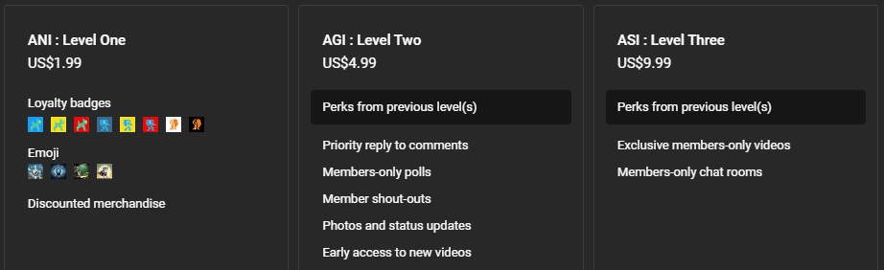

Membership has its privileges
Notes:
https://www.youtube.com/channel/UC35ZpwldGw7ZJ5R-2sLijzw/join

Slide 5
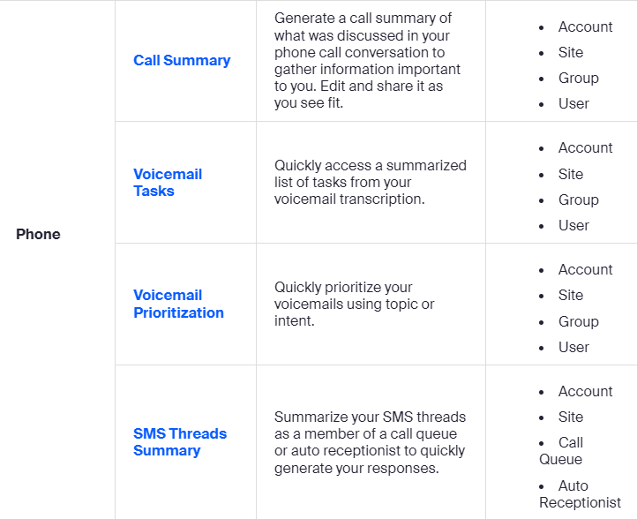

Slide 6
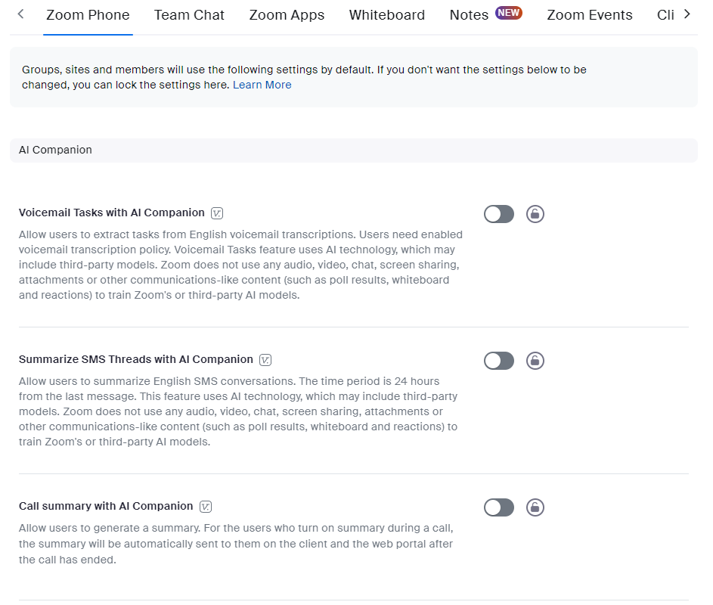

Slide 7

Call summary
Notes:
https://support.zoom.com/hc/en/article?id=zm_kb&sysparm_article=KB0074867

Slide 8
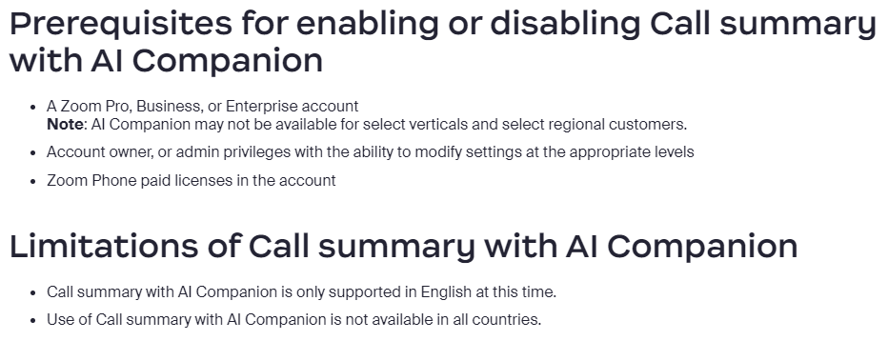

Slide 9
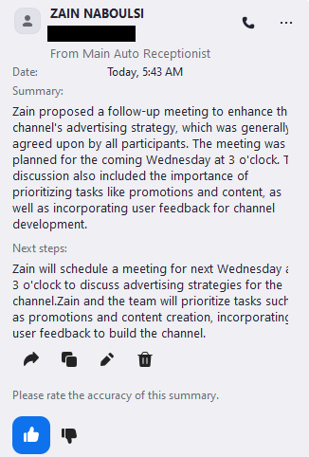
Demo: Call Summary

Slide 10

Voicemail Tasks
Notes:
https://support.zoom.com/hc/en/article?id=zm_kb&sysparm_article=KB0074870

Slide 11
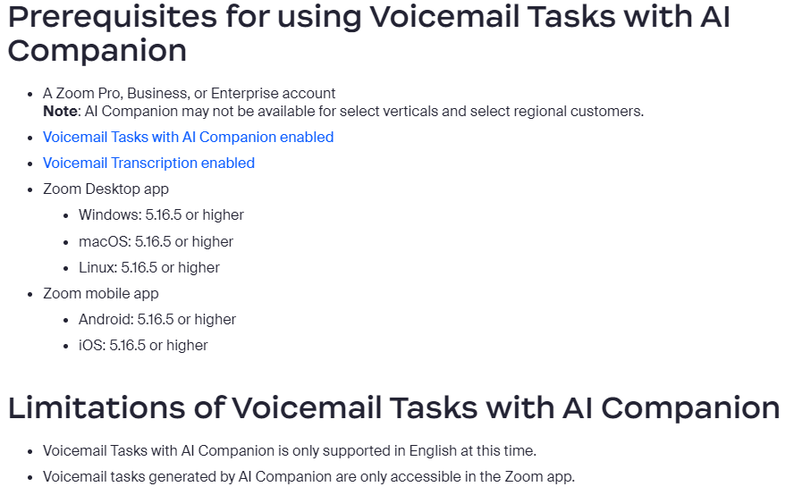

Slide 12
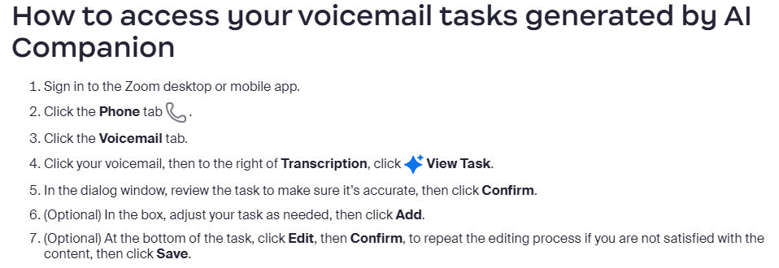

Slide 13
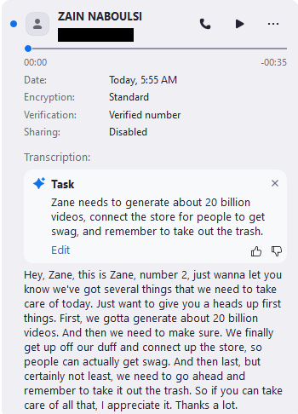
Demo: voicemail tasks

Slide 14

Voicemail Prioritization
Notes:
https://support.zoom.com/hc/en/article?id=zm_kb&sysparm_article=KB0074872

Slide 15
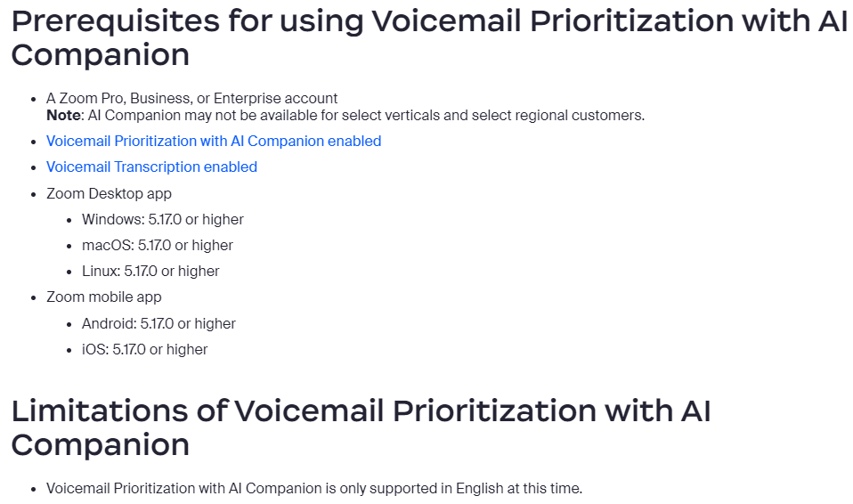

Slide 16
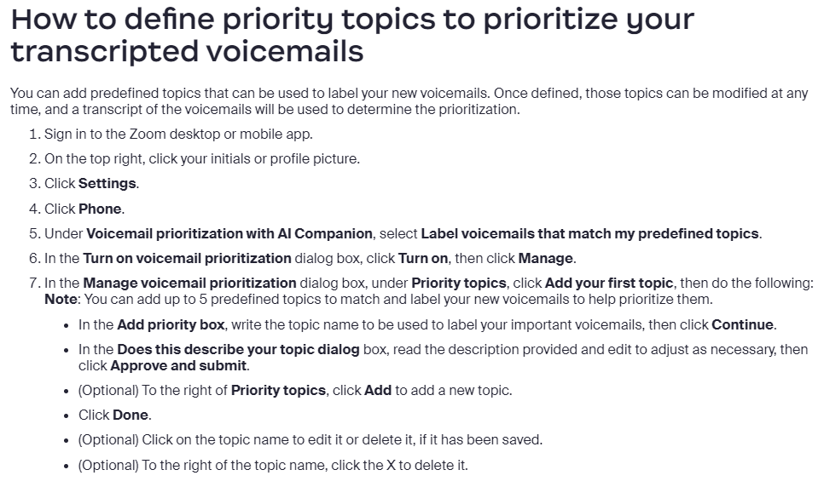

Slide 17
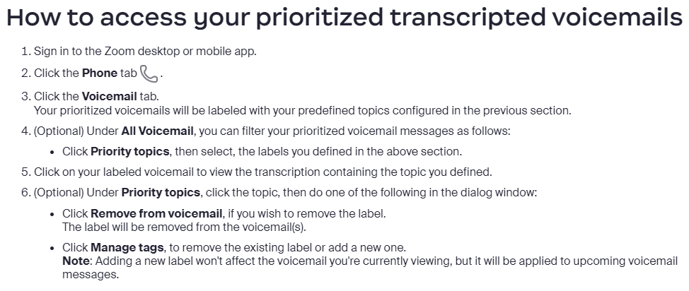

Slide 18

Demo: Voicemail Prioritization

Slide 19
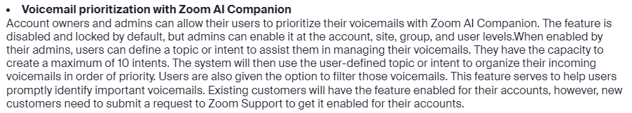
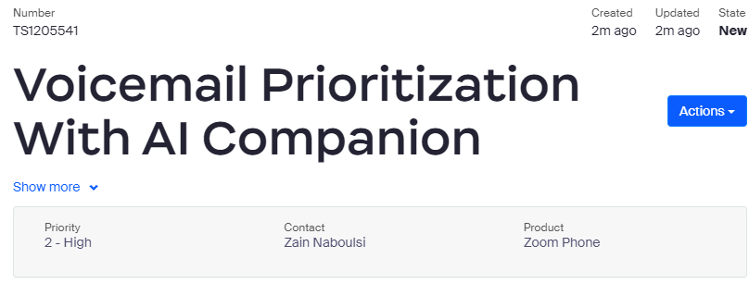

Slide 20

Summarize SMS threads
Notes:
https://support.zoom.com/hc/en/article?id=zm_kb&sysparm_article=KB0074874

Slide 21
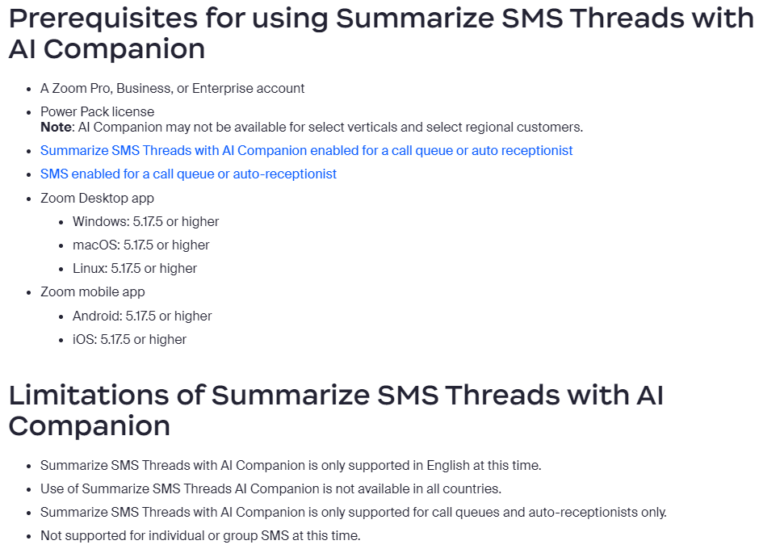

Slide 22
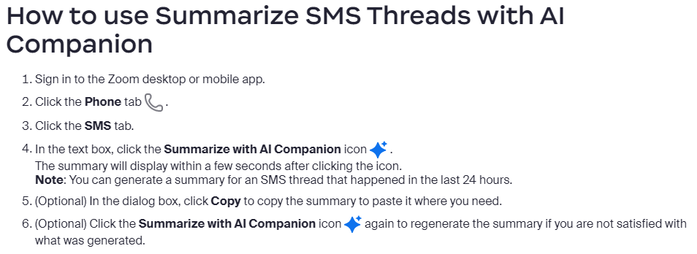

Slide 23
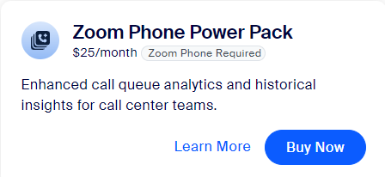
Demo: Summarize SMS Threads
Notes:
https://www.zoom.com/en/products/voip-phone/?_ga=2.178864740.1163951098.1713955348-1246947342.1707764599

Slide 24


